Slide 1
WSN@work the controller Peter Van Aken

Slide 2
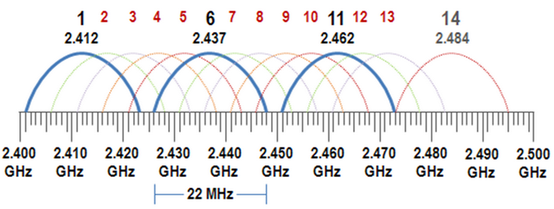

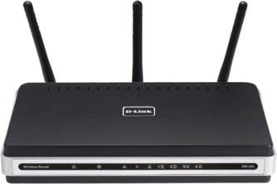
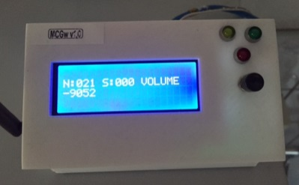
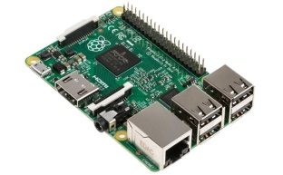


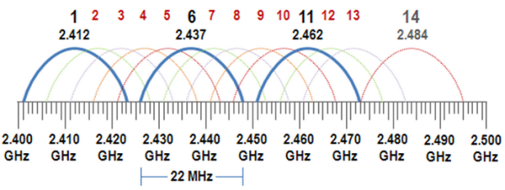
WSN@Work topology
Wifi : auto channel
http(s)://192.168.0.107
Open SSID : WSNatWork
(192.168.0.1)
LAN
192.168.0.x
(192.168.0.225)
(192.168.0.107)
MQTT client Gateway
Controller
Wireless Sensor Network
Sensor / Actuator node
Repeater node
selfhealing
meshing
w/battery powered
ISM (Industrial Scientific Medical) license-free band
Channel 76
(2.476Ghz)
LED-nodes

Slide 3
Topics
Getting your Raspberry Pi 2 ready
Installing OpenHab
MQTT as bridge

Slide 4
Getting your RPiV2 ready
Info source : https://www.raspberrypi.org
Install methods :
NOOBS : OR
https://www.raspberrypi.org/help/noobs-setup/
Select your OS during PI startup
Native (Raspian) (my preference)
Workflow for both methods is the same :
Install an SD write on your OS (Linux/Mac/Windows)
Burn .img to SD
Boot Rpi with SD and configure
BACKUP : done with the same SD writer !! (keep a base image)

Slide 5
Getting your RPiV2 ready
“sudo raspi-config” is your best friend
1 : expand filesystem
5 : internationalisation options
I1 : nl_BE@euro ISO_8859_15
I2 : Europe/Brussel
I3 : keyboard (!! Default is QWERTY)
reboot
6 : enable camera (if available)
9 : advanced options
A4 : enable SSH
2 : change user passwd
reboot

Slide 6
Getting your RPiV2 ready
Network access :
Wired : woks out-of-the box
Wireless : https://www.raspberrypi.org/documentation/configuration/wireless/wireless-cli.md
SSH with root :
Set passwd : sudo passwd root
In /etc/ssh/sshd_config : search for “PermitRootLogin” and change this to “yes”
Now SSH access is working for both users
sudo apt-get update
sudo apt-get upgrade
READY to run headless : backup base image

Slide 7
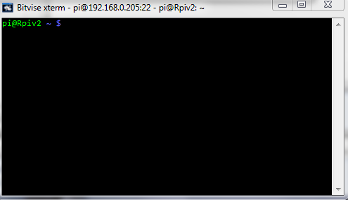
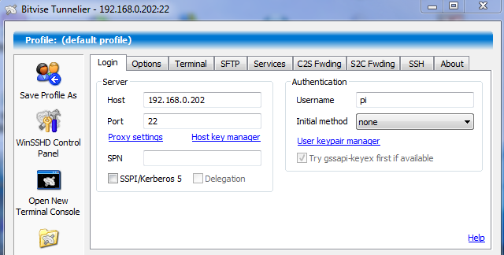
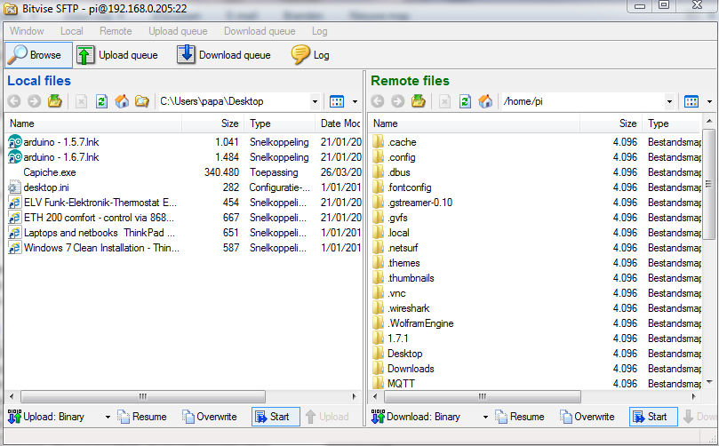
Getting your RPiV2 ready
SSH / file transfer tools :
FileZilla, Putty, BitVise (https://www.bitvise.com/download-area), ....

Slide 8
Getting your RPiV2 ready : optional
VNC
sudo apt-get install tightvncserver
start once to set passwd
vncserver :1 –geometry 1920x1080 –depth 24
Automatic start during boot :
copy “vncstart” to /etc/init.d in your PI
sudo chmod +x /etc/init.d/vncstart
sudo update-rc.d vncstart defaults
OR : https://www.raspberrypi.org/documentation/remote-access/vnc/
This is my base image backup

Slide 9
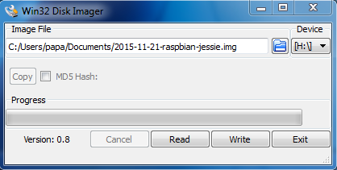
Getting your RPiV2 ready : optional
Windows SD image backup tool : https://www.google.be/?gws_rd=ssl#q=win32diskimager
Linux : google & add
MacOS : google & add

Slide 10
Getting your RPiV2 ready : optional
Samba : http://raspberrywebserver.com/serveradmin/share-your-raspberry-pis-files-and-folders-across-a-network.html
Change hostname : http://raspberrywebserver.com/serveradmin/change-your-pis-host-name.html
Backup data to “the Cloud” : http://raspberrywebserver.com/serveradmin/back-up-your-pi-to-your-google-drive.html
Touchscreen keyboard :
sudo apt-get install matchbox
GVIM :
sudo apt-get install vim-gui-common

Slide 11
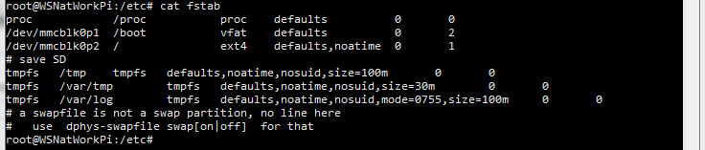
Getting your RPiV2 ready : optional
Extend SD card lifetime : http://www.zdnet.com/article/raspberry-pi-extending-the-life-of-the-sd-card/

Slide 12
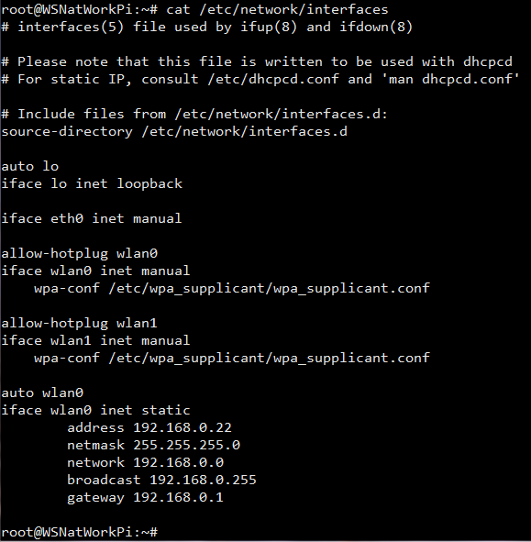
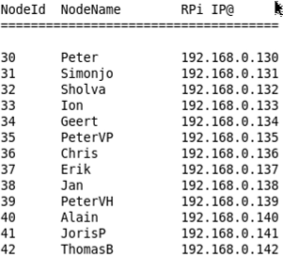
Static IP@ for the workshop
(100 + YOUR NodeID)
Add
(see NodeIdAllocation.txt)

Slide 13
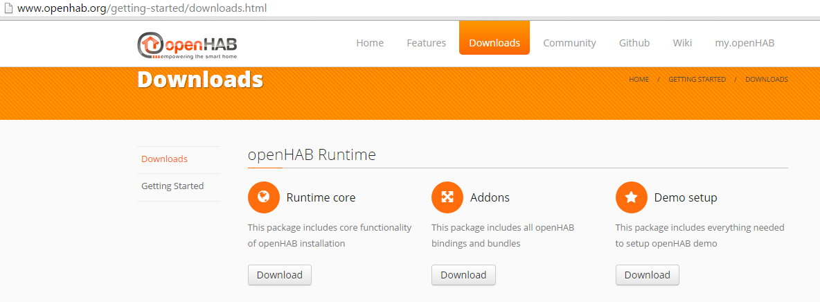

Installing Openhab
Info source : http://www.openhab.org/

Slide 14
Installing Openhab
Copy “Openhab 1.8.0” folder under /home/pi (ssh/...)
This folder includes :
demo
addons used in WSN. Add from “Openhab 1.8.0 Addons” depending upon your need. Startup-time !
In /home/pi/Openhab 1.8.0 : chmod 755 *.sh

Slide 15
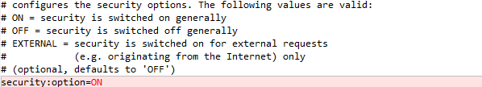

Configuring Openhab : security
/home/pi/Openhab 1.8.0/configuration/openhab.cfg
/home/pi/Openhab 1.8.0/configuration/users.cfg

Slide 16
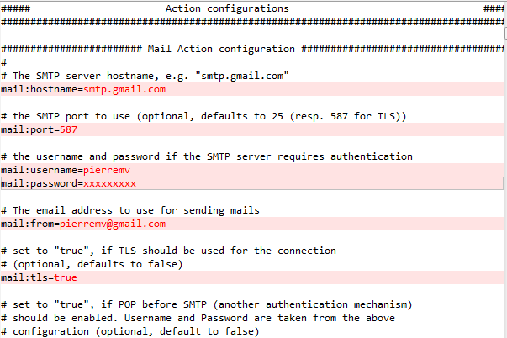
Configuring Openhab : SMTP
/home/pi/Openhab 1.8.0/configuration/openhab.cfg
...this will allow Openhab to send you emails based on rules...

Slide 17
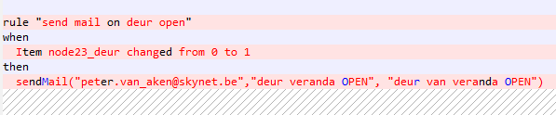
Configuring Openhab : SMTP
Example rule : no need to add for workshop

Slide 18
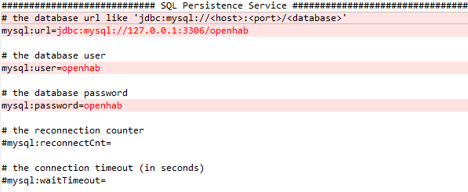
Configuring Openhab : MySQL
/home/pi/Openhab 1.8.0/configuration/openhab.cfg
this will allow Openhab to store sensor data
MySQL can be running remotely or on NAS device. In this example it’s local in Rpi
See optional section for MySQL installation

Slide 19
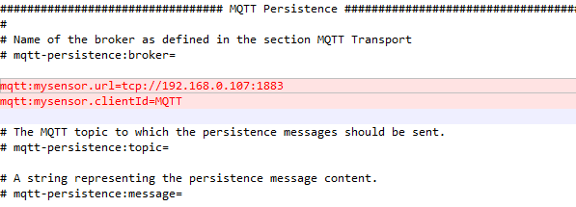

Configuring Openhab : MQTT
/home/pi/Openhab 1.8.0/configuration/openhab.cfg
Point to the location were your MQTT broker (e.g. Mosquitto) is running. This must be synced with the gateway.
For WSNatWork workshop : stick to this IP@
ClientId must
be UNIQUE
In network
...these are the basic to get WSNatWork up and running but there is much, much more inside...

Slide 20
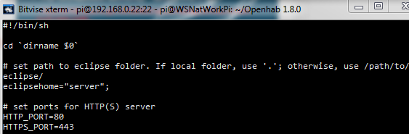
Configuring Openhab : port
/home/pi/Openhab 1.8.0/start.sh
sudo vi start.sh (same for start_debug.sh)

Slide 21
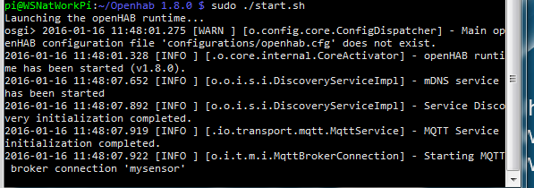
Start Openhab
In /home/pi/Openhab 1.8.0/configuration/
Without debug : sudo ./start.sh
With debug : sudo ./start_debug.sh

Slide 22
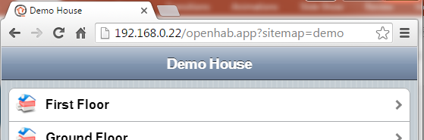
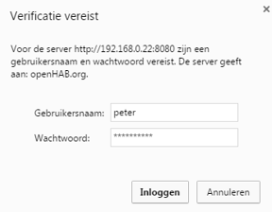
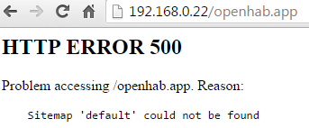
Connect to Openhab

Slide 23

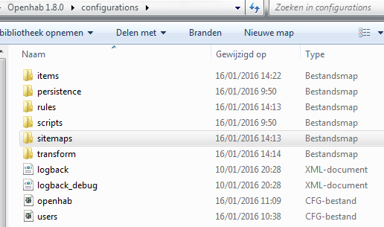
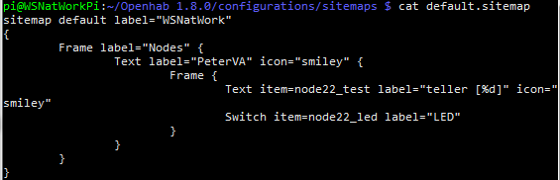
Moving your LED-node into Openhab

Slide 24
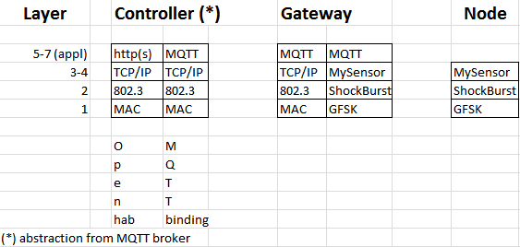
Internals : e2e WSNatWork stack
Wired/ Wireless
RF

Slide 25

Internals : MQTT broker
WSNatWork is using Mosquitto 3.1.1. (free open source SW)
About MQTT :

Slide 26
Internals : MQTT broker
Basic concept in a nutshell :
works with topics (MyMQTT/22/1/V_VOLUME...)
MQTT clients subscribe to interesed topics in MQTT broker
MQTT clients publish topics to MQTT broker
MQTT broker publishes topics to subscribed MQTT clients (kind of multicast)
Very good explanation : http://www.hivemq.com/blog/mqtt-essentials/ (part 1 – 11)
MQTT Broker
MQTT Client
MQTT Client

Slide 27
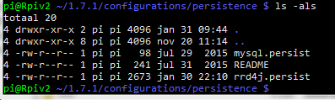
Openhab and persistency
Not restricted to single data storage : MySQL, cloud, ... (see https://github.com/openhab/openhab/wiki/Persistence)
In WSN-at-Work :
RR4DJ : is a high performance data logging and graphing system for time series data. Ideal to get trend on low BW devices (eg smartphone in radio network)
MySQL : accurate logging
Configuration :

Slide 28
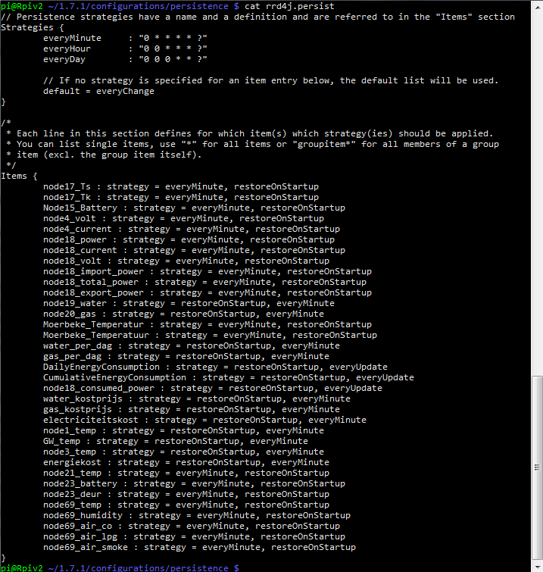
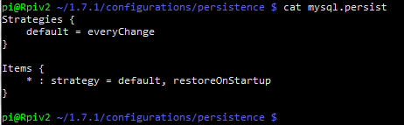
Openhab and persistency

Slide 29
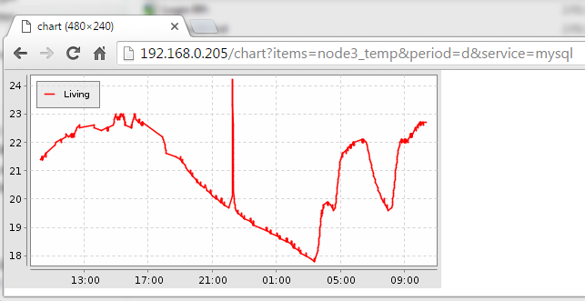
Openhab and persistency
Demo using HABMIN to query persistent data
From internet explorer using MySQL: (apache2 has to be running !!)

Slide 30
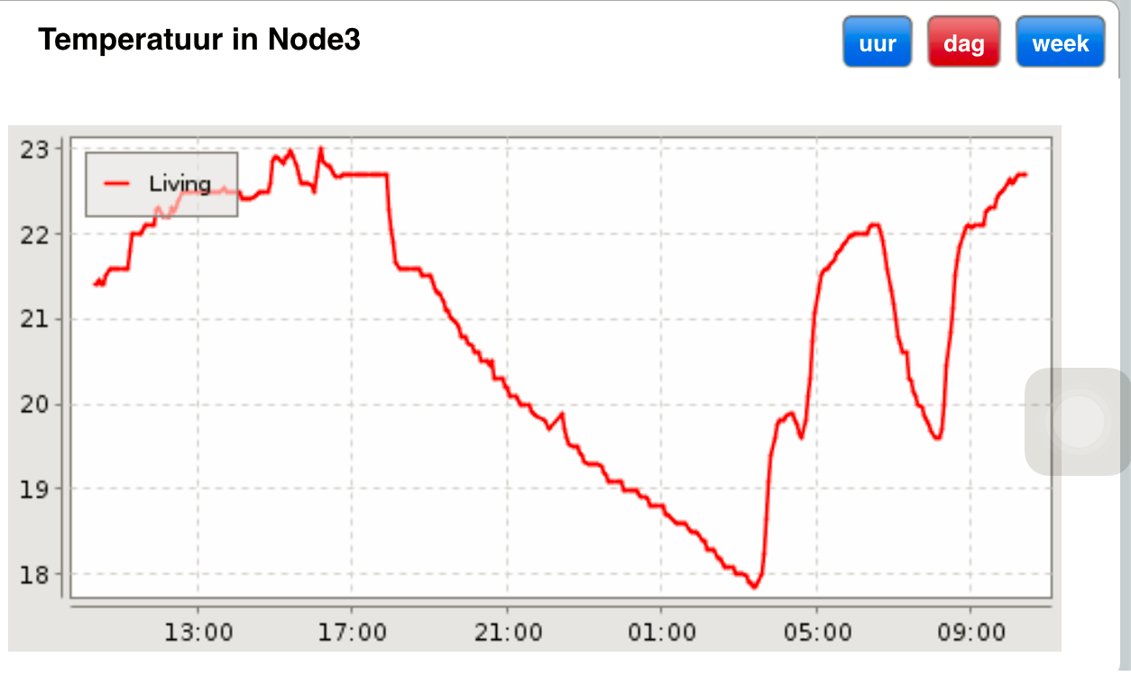
Openhab and persistency
From Smartphone using RR4DJ :

Slide 31
Openhab and persistency
Exercise : make your LED-node counter persistent

Slide 32
Openhab and rules
”Rules” are used for automating processes (see : https://github.com/openhab/openhab/wiki/Rules#introduction)
Location :
Different ways to trigger : item, time, system event, ...

Slide 33
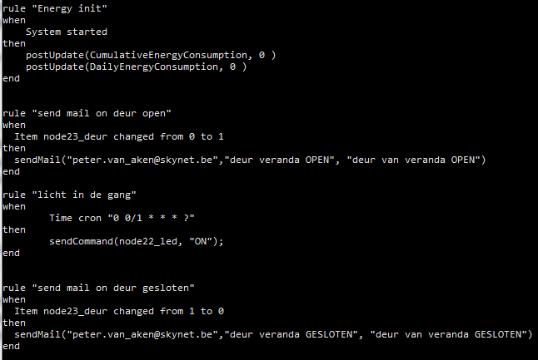
Openhab and rules
Samples :

Slide 34
Openhab and rules
Exercises :
Automate your LED on your LED-node to turn on/off every minute.
Send yourself an email if the node is turned on.

Slide 35
Optional

Slide 36
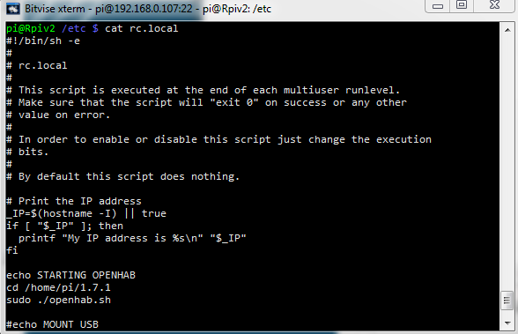
Openhab @ startup

Slide 37
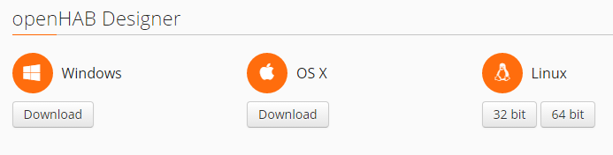
Habmin
Already included :
http:<your Openhab ip>/habmin
Alternative :

Slide 38
MySQL
- install : sudo apt-get install mysql-server
add openhab user: mysql –u root –p
create database openhab;
CREATE USER 'openhab'@'localhost' IDENTIFIED BY 'openhab';
GRANT ALL PRIVILEGES ON openhab.* TO 'openhab'@'localhost';
tips :
- Drop database : drop database if exists openhab;
- Select database : use openhab;
- Show tables : show tables;
- Create database : create database openhab;

Slide 39
Wireshark & MQTT
see :
https://github.com/menudoproblema/Wireshark-MQTT
start :
wireshark -X lua_script:mqtt.lua
capture :
mqtt.publish.topic matches "MyMQTT/69/6"
prefix
nodeId
sensor

Slide 40
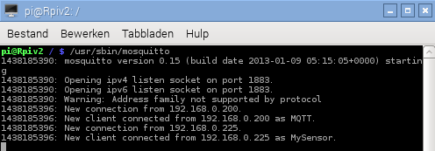
MQTT broker : Mosquitto
sudo apt-get install mosquitto mosquitto-clients python-mosquitto
sudo /etc/init.d/mosquitto stop
start :

Slide 41
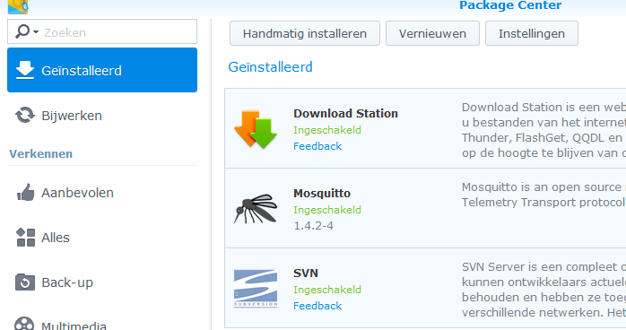
MQTT broker : Mosquitto on Synology NAS

Slide 42
MQTT broker / live capture using wireshark
Openhab (see your IP@)
MQTT broker
(192.168.0.107)
Gateway
(LED) node
connect
publish
see air capture workshop 1.1
publish
publish

